Slide 1
Group 6
DMT-V

Slide 2
GUI and HUD Development
Graphical User Interface (GUI):
Representative of the atmosphere we want in the game.
Quality of GUI is not easily measured; it’s more personal opinion. However, some things can be measured (e.g.., how many clicks to start a game, advanced options readily available, etc.)
Heads-Up Display (HUD):
Shown on each player’s screen while the game is in progress.
Displays the most important information about the player’s character, teammates, and overall environment.
Minimal enough not to cover the entire screen, yet still informative of the gameplay status.

Slide 3
Main Screen
Spiller, Alyn. “Dungeon Passage.” DeviantArt. 2012, http://alynspiller.deviantart.com/art/Dungeon-Passage-280728956

Slide 4
Game Lobby as Host
De Ro, Jonas. “Temple Ruins.” DeviantArt. 2012, http://jonasdero.deviantart.com/art/Temple-Ruins-326743176

Slide 5
New Game Screen as Host
De Ro, Jonas. “Oak’s Crossing.” DeviantArt. 2011, http://jonasdero.deviantart.com/art/Oak-s-Crossing-244821108

Slide 6
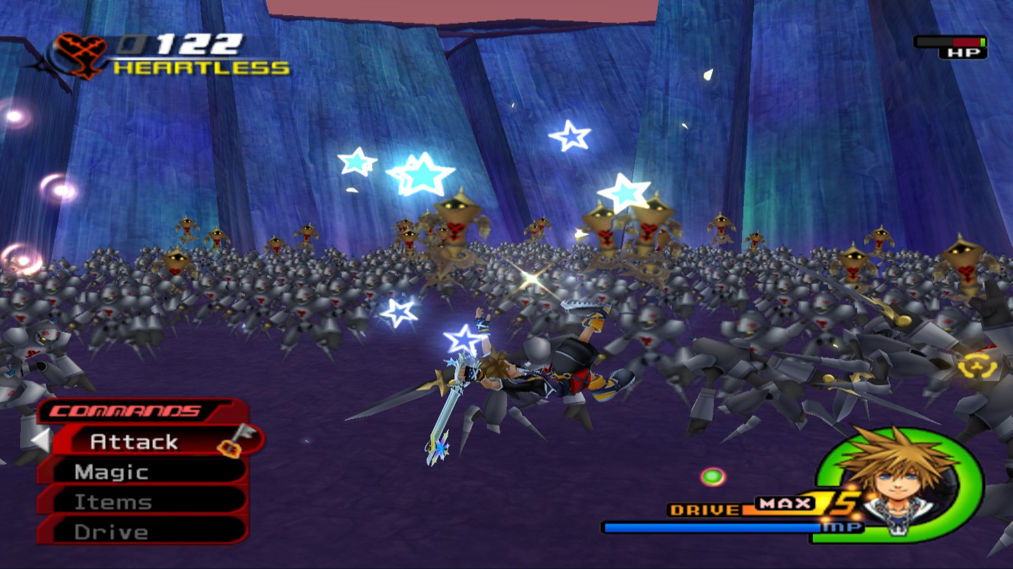
Heads-Up Display (Example)
Kingdom Hearts II. Square Enix Holdings. 2005. Video game.

Slide 7
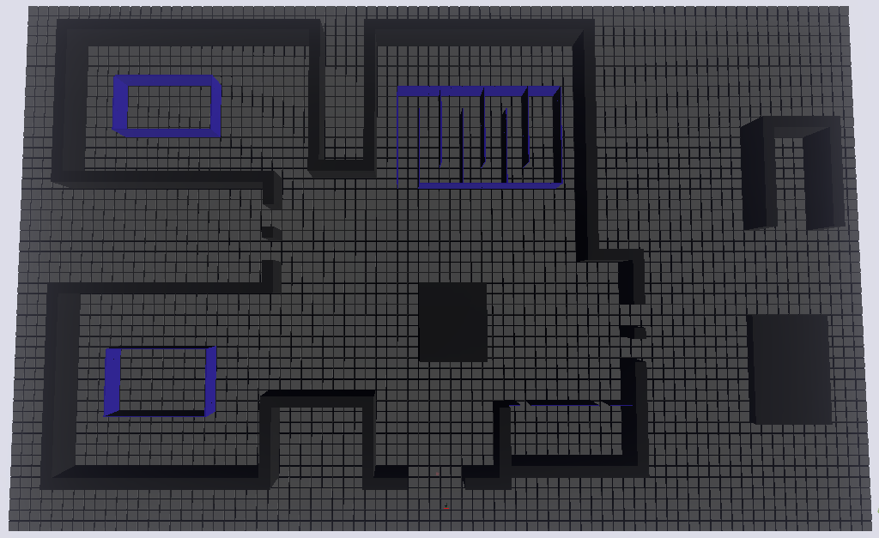
Town level without map textures

Slide 8
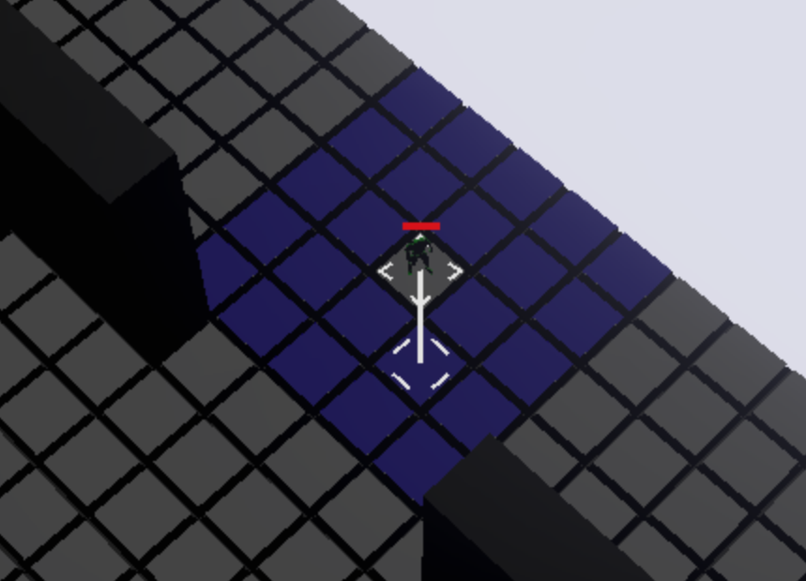
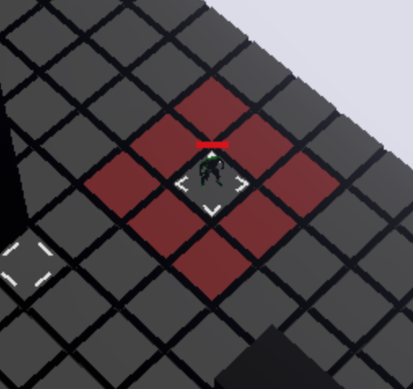
Player movement and attack

Slide 9
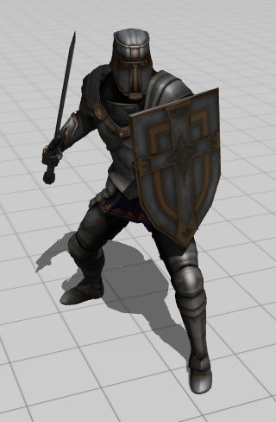
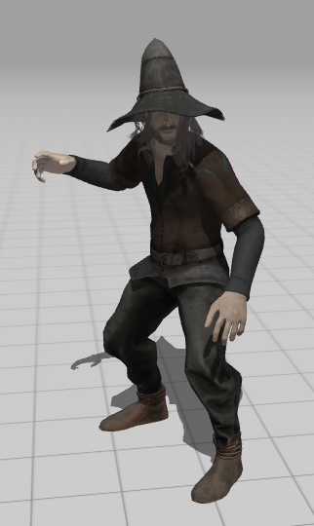
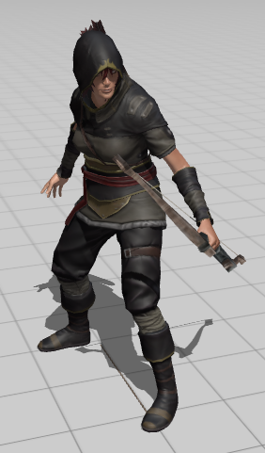
Characters
Knight
Mage
Archer

Slide 10
Player Attributes & Level System
Balance is key!
What is the best way to make the game fair yet somewhat difficult?

Slide 11
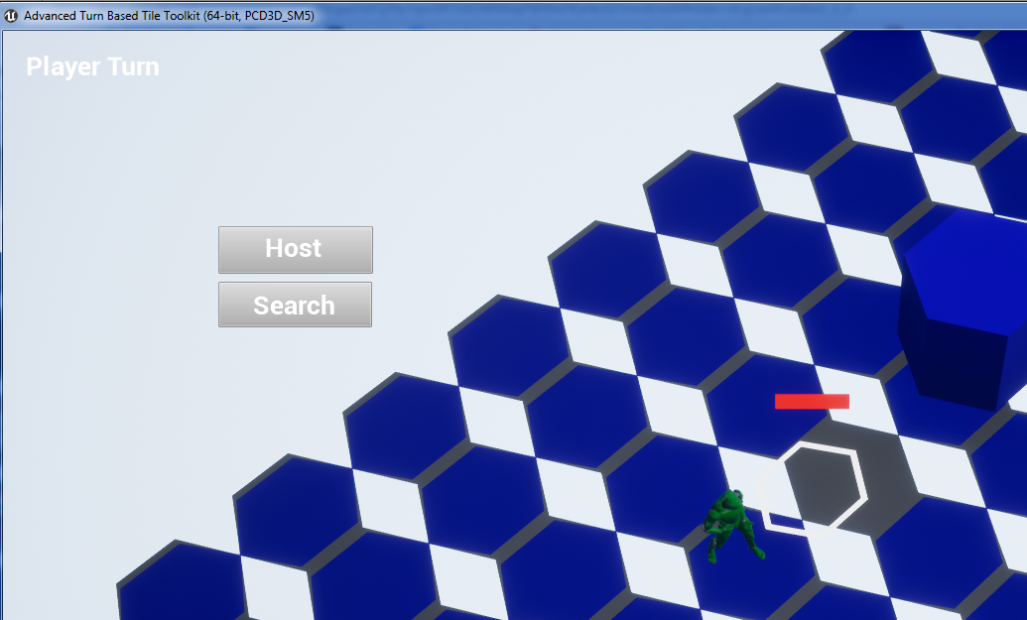
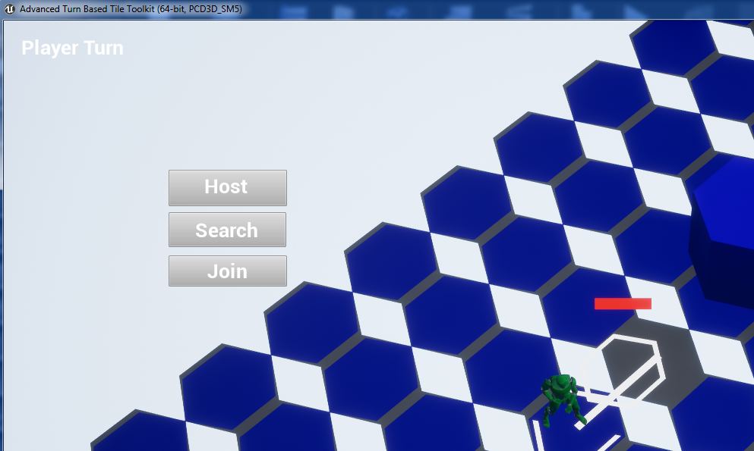
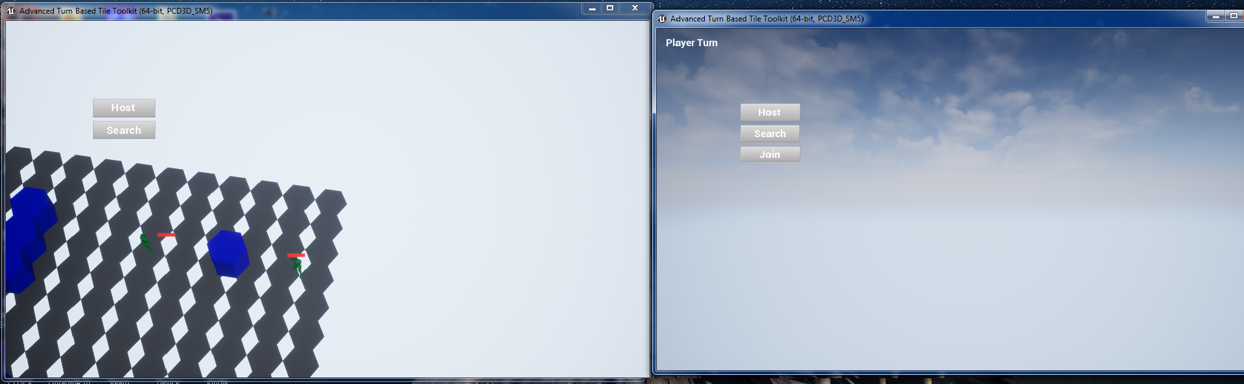
Multiplayer Prototype
Just synchronizes sessions
Requires both client and server to “Join” almost simultaneously
Camera views not correct
1.
2.
3.

Slide 12
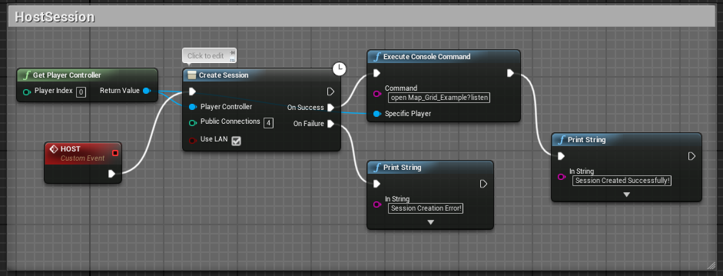
Launch Map
Print Success String to View Port
The Multiplayer menu will link an event to this, e.g., pressing ‘M’ key
On Failure
The red box (Custom Event) might be tied to the Create a Lobby button on the main menu
Host creates a session, and upon success, launches the map with the option to listen for other players to join

Slide 13
Resources
De Ro, Jonas. “Oak’s Crossing.” DeviantArt. 2011, http://jonasdero.deviantart.com/art/Oak-s-Crossing-244821108
De Ro, Jonas. “Temple Ruins.” DeviantArt. 2012, http://jonasdero.deviantart.com/art/Temple-Ruins-326743176
Kingdom Hearts II. Square Enix Holdings. 2005. Video game.
Spiller, Alyn. “Dungeon Passage.” DeviantArt. 2012, http://alynspiller.deviantart.com/art/Dungeon-Passage-280728956

